Slide 1
COS 326 Database Systems
Lecture 9
Semi-Structured Data and XML (1)
Chapter 13 (7th edition)
Tuesday 20 August 2024

Slide 2
In this lecture
Introduction to Structured, Semi-structured and Unstructured Data
XML
XML Hierarchical (Tree) Data Model
XML Schema

Slide 3
Introduction
Databases function as data sources for Web applications
HTML
Used in static Web pages
XML, JSON
Self-describing documents
Dynamic Web pages
Chapter focus: XML data model and languages

Slide 4
Structured, Semistructured, and Unstructured Data
Structured data
Stored in relational database
Semistructured data
Not all data has identical structure
Schema information mixed in
Self-describing
Directed graph model
Unstructured data
Limited data type indication
Example: Web pages in HTML

Slide 5
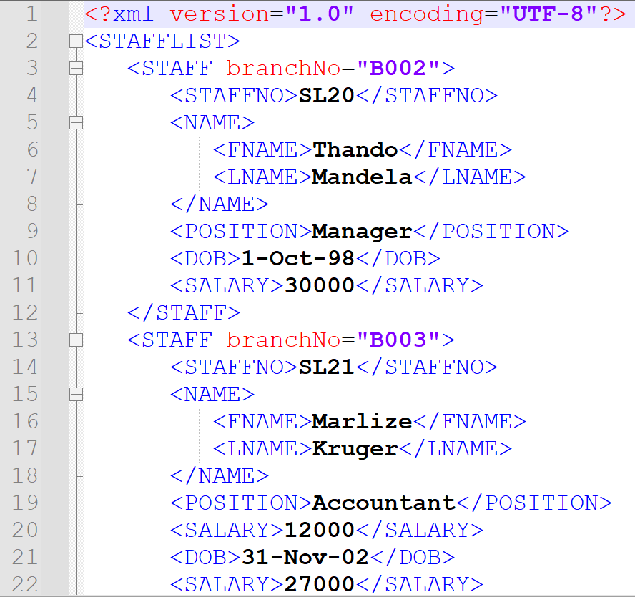
Semi-structured data
Data that may be irregular or incomplete and have a structure that may change rapidly or unpredictably.
e.g. XML documents
may have a structure, but may change
aka schema-less or self-describing
no separate schema
schema is part of the data
relational,
object-oriented,
object-relational DBMSs
Require pre-defined schema
© Pearson Education Limited 1995, 2005

Slide 6
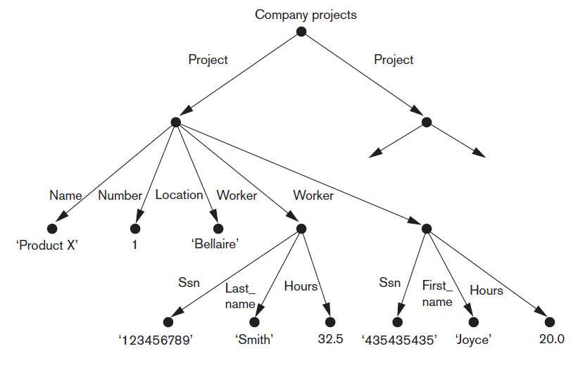
Directed Graph Model for Semistructured Data
Figure 13.1 Representing semistructured data as a graph

Slide 7
XML (eXtensible Markup Language)
Meta-language (language for describing other languages)
enables designers to create their own customized tags
provide functionality not available with HTML
1998: XML 1.0 by World Wide Web Consortium (W3C)
Has impacted many types of systems e.g.
distributed systems
database management etc.
de facto standard for data communication
Replacing EDI (Electronic Data Interchange)

Slide 8
XML: what you already know
COS216 & INF272 Revision
1. XML file: e.g. myfile.xml
2. Format of an XML document
header, tags, attributes, namespaces, etc
3. Document Object Model (DOM)
tree structure for an xml document
4. XML document validation
Document Type Definitions (DTDs)
Schemas (Microsoft XML schema, W3C schema)
5. Conversion of XML data to formatted text documents
Extensible Stylesheet Language (XSL, XSLT)

Slide 9
Reading for the student
Introduction to XML
Advantages of XML
Overview of XML
Document Type Definitions (DTDs)
XML-related technologies
DCOM and SAX
Namespaces
XLS and XLST
© Pearson Education Limited 1995, 2005

Slide 10
XML Hierarchical (Tree) Data Model
Basic object: XML document
Element
Simple
Complex
Schema document defines element names
Attribute
Document types
Data-centric
Document-centric
Hybrid

Slide 11
XML Schema (1)
XML schema language
Commonly known as XML Schema Definition (XSD)
Specifies document structure
Same syntax rules as XML documents
Elements, attributes, keys, references, and identifiers
Example: Figure 13.5 in the prescribed textbook

Slide 12
XML Schema (2)
XML namespace
Defines set of commands that can be used
Annotations, documentation, and language used
Elements and types
Root element
First-level elements
Specifying element type and min and max occurrences

Slide 13
XML Schema Example
<?xml version = "1.0" encoding = "UTF-8"?>
<xs:schema xmlns:xs = "http://www.w3.org/2001/XMLSchema">
<xs:element name = "contact">
<xs:complexType>
<xs:sequence>
<xs:element name = "name" type = "xs:string" />
<xs:element name = "company" type = "xs:string" />
<xs:element name = "phone" type = "xs:int" />
</xs:sequence>
</xs:complexType>
</xs:element>
</xs:schema>

Slide 14
XML Schema (3)
Keys
Constraints that correspond to relational database
Primary key
Foreign key
Complex elements
xsd:complexType
Composite (compound) attributes

Slide 15
XML Schema Definition Types
You can define XML schema elements in the following ways:
Simple Types
Complex Types
Global Types

Slide 16
XML Schema Definition Types: Simple Type
Simple type element is used only in the context of the text.
Some of the predefined simple types are:
xs:integer, xs:boolean, xs:string, xs:date.
An example of a simple type element
<xs:element name = "phone_number" type = "xs:int" />

Slide 17
XML Schema Definition Types: Complex Type
A complex type is a container for other element definitions.
This allows you to specify which child elements an element can contain and to provide some structure within your XML documents.
An example of a complex type element:
<xs:element name = "Address">
<xs:complexType>
<xs:sequence>
<xs:element name = "name" type = "xs:string" />
<xs:element name = "company" type = "xs:string" />
<xs:element name = "phone" type = "xs:int" />
</xs:sequence>
</xs:complexType>
</xs:element>

Slide 18
XML Schema Definition Types: Global Type
A global type allows you to define a single type in your document, which can be used by all other references.
For example, suppose you want to generalise the person and company for different addresses of the company. In such case, you can define a general type as follows
Example of a global type element:
<xs:element name = "AddressType">
<xs:complexType>
<xs:sequence>
<xs:element name = "name" type = "xs:string" />
<xs:element name = "company" type = "xs:string" />
</xs:sequence>
</xs:complexType>
</xs:element>

Slide 19
Storing and Extracting XML Documents from Databases
Use file system or DBMS to store documents as text
Use DBMS to store document contents as data elements
Design specialized system to store XML data
Create or publish custom XML documents from preexisting relational databases
This approach explored further in section 13.6 (prescribed textbook)

